Slide 1
Data Mining and Machine Learning II
Chapter 1 – Introduction to Data Mining

Slide 2
Objectives
Understand the basic knowledge about Data Mining
Study different Data Mining projects and know how to build a project from scratch
Be able to analyze, evaluate raw data, choose model for a specific problem
Propose solutions and approaches to solve real-world Data Mining problems

Slide 3
“Data is a precious thing and will last longer than the systems themselves ”
by Sir. Tim Berners Lee, Creator of World Wide Web

Slide 4
Data, unlimited resources
Data on human behavior: propose strategy for marketing, business
Data on animal’s movement: propose solution to support nearly extincted animals
Data on weather: predict accurately weather in near future, catastrophe
Data on biology, earth, astronomy, business, sports, etc.

Slide 5
Timeline
Statistics (~18th century)
Artificial Intelligence (1943)
Machine Learning (1960)
Deep Learning (1967)
Data Mining (~1990)
Data Science (created in 1960, 2001 officially)
Big Data (~2012)

Slide 6
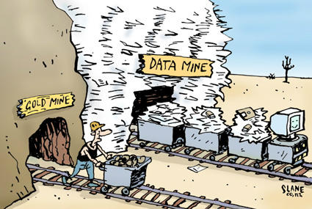
Data Mining
Officially introduced in 1995 by Computer Science community.
Involving methods at the intersection of artificial intelligence, machine learning, statistics, and database systems.

Slide 7
Data
Information
Knowledge
Knowledge
Data
Information can be converted into knowledge about historical patterns and future trends.
Any facts, numbers, images, graphs, texts, or videos can be processed by a computer.
Information
Information is data in context and with meaning attached.

Slide 8
Why mine data?
Lots of data is being collected from computer, mobile, sensor, satellite, etc, and stored at enormous speed
In 2020, 44 zettabytes (ZB) data in the global world (1 ZB = 10M TB)
1.2 trillion searches every year with Google
In 2019, 188 million emails were sent in the world every minute.
YouTube had 4.5 million videos viewed every minute in 2019.

Slide 9
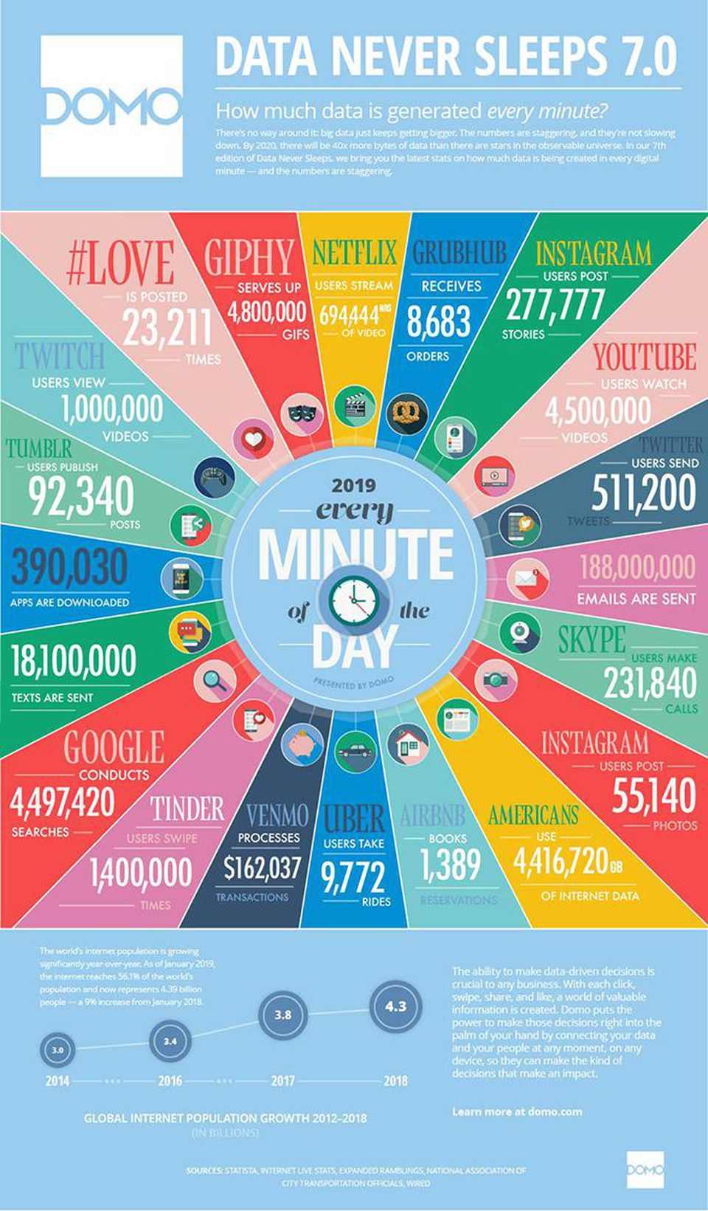

Slide 10
Why mine data?
Human analysts may take weeks, months to discover useful information.
Much of the data is never analyzed at all.
Computers have become cheaper and more powerful.
Data mining tools predict future trends and behaviors, allowing businesses to make proactive, knowledge-driven decisions.
Many domains can use the application of Data Mining.

Slide 11
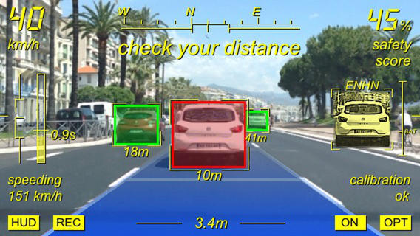
Smart Car – Auto-Driving
Object Recognition
Problem: images/videos with different objects' shape and figures are given, detect and recognize these objects in new images/videos
Solution: find object regions in images (or videos), classify them into known classes

Slide 12
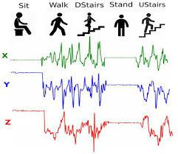
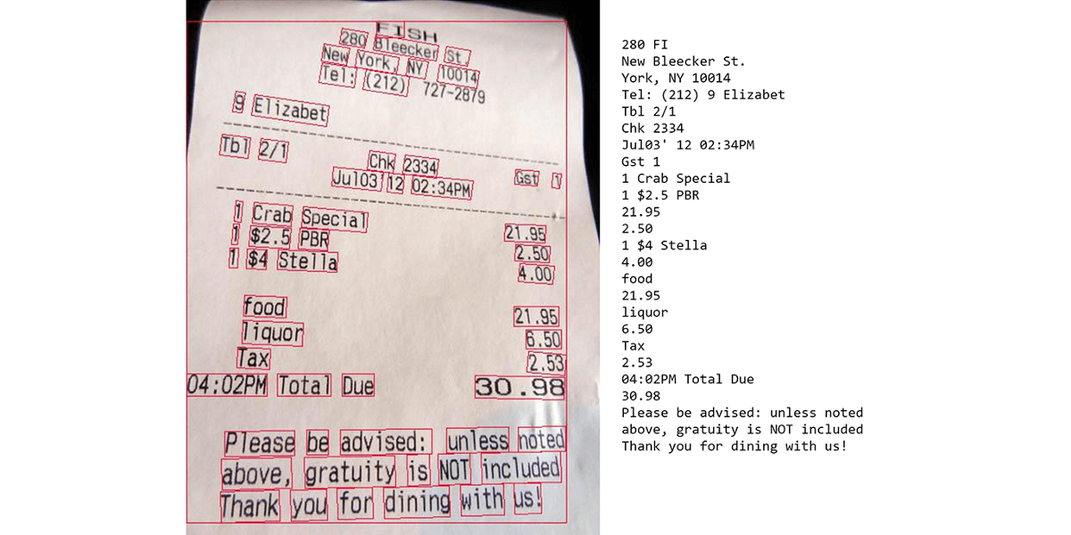
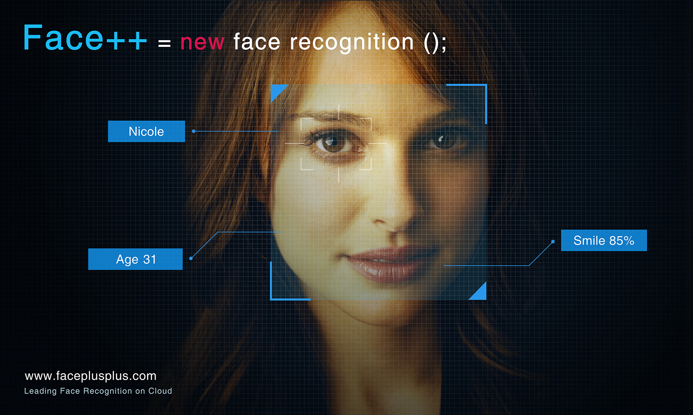

Pattern Recognition
Optical Character Recognition
Fingerprint Recognition
Face Recognition
Human Activity Recognition

Slide 13
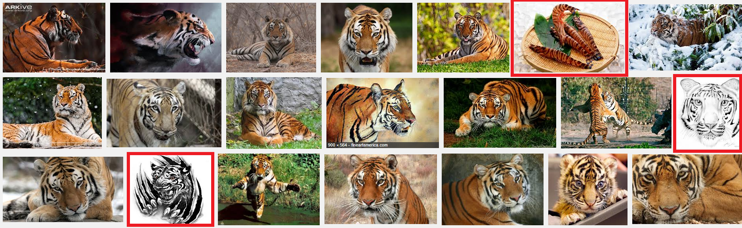
Image classification
Information Retrieval
Problem: database with known images which are classified into many groups due to the content
Solution: compare the similarity between images and find the similar images according to the content and search keywords

Slide 14

Recommendation System
Problem: the list of products bought by customers, customers rate products. Is it possible to recommend products to new customers?
Solution: collaborative filter to group customers having the same buying behaviors

Slide 15

Intelligent Personal Assistant
Chat Bot – Virtual Assistant
Problem: the list of known texts, voices, video, etc.
Solution: mixed various techniques i.e. natural language processing, speech recognition, text to speech, etc.

Slide 16
What is Data Mining?
“The non trivial extraction of implicit, previously unknown, and potentially useful information from data”
W. J. Frawley et al.

Slide 17
What is Data Mining?
An interdisciplinary field
Databases: data sources for data mining problems
Mathematics and Statistics: tools for data analysis
Artificial Intelligence/Machine Learning: algorithms for data knowledge discovery

Slide 18
Data Mining vs Statistics
Data Mining
there is few a priori hypotheses
data is usually already collected a priori
analysis is typically data-driven not hypothesis-driven
often algorithm-oriented rather than model-oriented
Statistics
at first, hypothesize problems, then collect data, then analyze
often model-oriented (strong parametric models)
difficult to automate.

Slide 19
Data Mining vs Machine Learning
Artificial Intelligence & Machine Learning: the algorithm part of the data mining process
“A learning system uses sample data to generate an updated basis for improved performance on subsequent data from the same source.'' Donald Michie (1991 - Computer Journal)
“Computer program that improves its performance at some task through experience.'' Tom Mitchell (1997 - Machine Learning)

Slide 20
Data Mining vs. Database
Data Mining is not
Data Warehousing: data storage format.
Structured Query Language: managing data held in a relational database.
OnLine Analytical Processing: answering multi-dimensional analytical queries swiftly.

Slide 21
Data Mining Objectives
Understanding discover structure inside unstructured data; extract meaning from noisy data; understand trends, patterns, correlations etc.
Prediction predict customer behavior, market and competition trends.

Slide 22
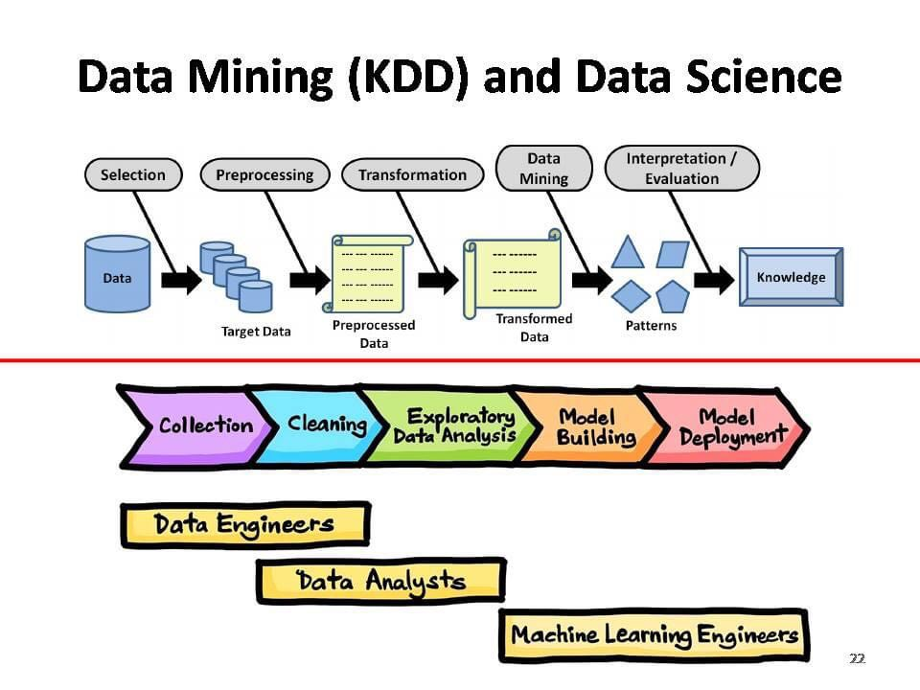
Data Mining Steps

Slide 23
What is Data Mining?
Understanding
Descriptive
Prediction
Predictive

Slide 24
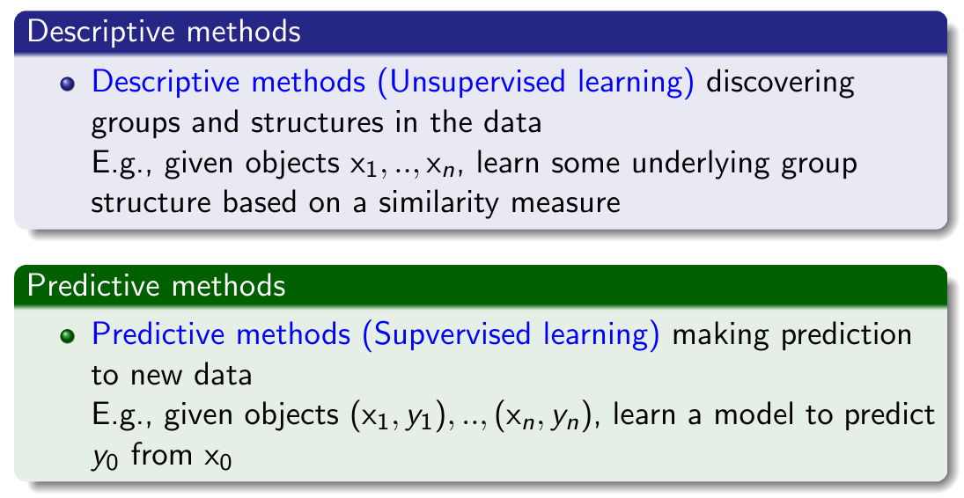
Data Models

Slide 25
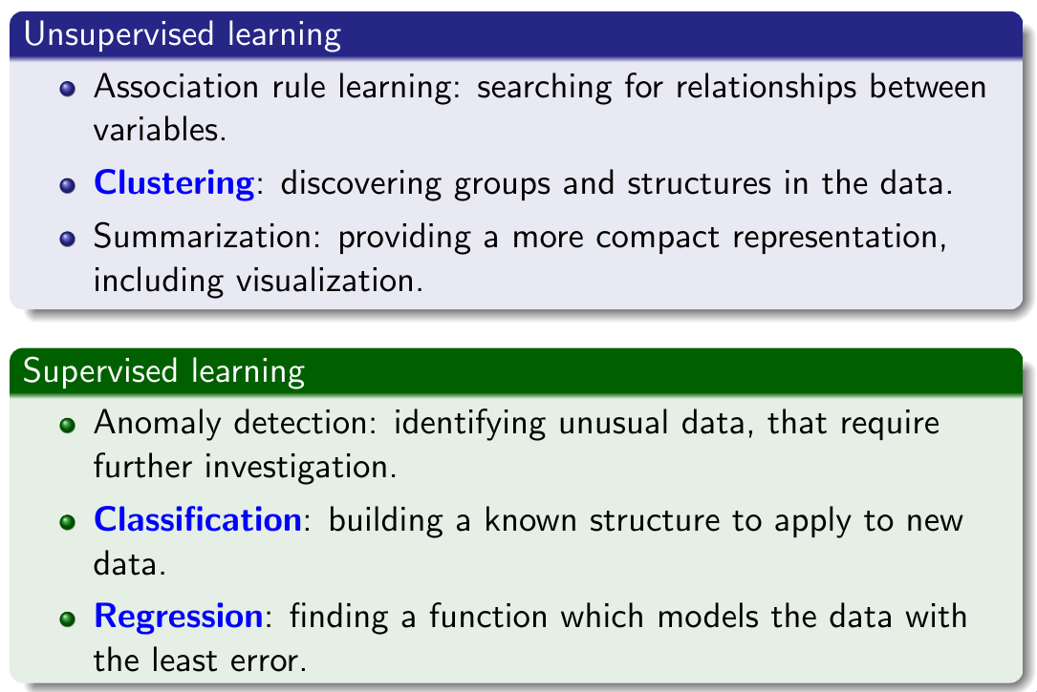
Data Models

Slide 26
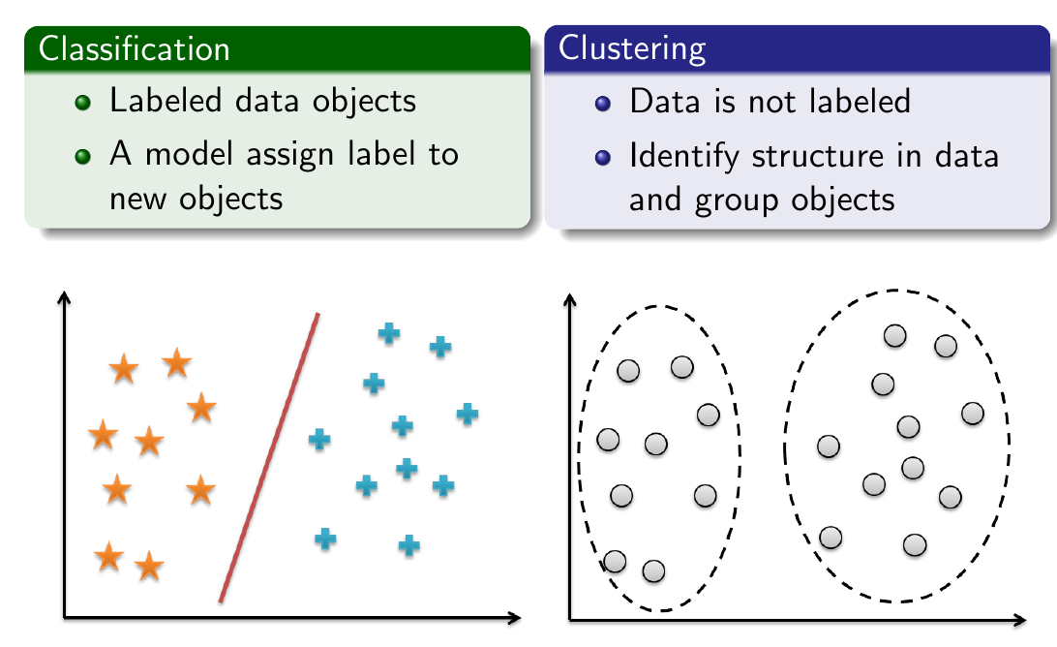
Data Models

